Slide 1
Food Truck Favorites haiyun yuan yun gu jiajia ding

Slide 2
Feature list
See images of food trucks of different cuisines
Check food truck info, menu, review & ratings
User login/register
Filter, search bar feature
Add to cart and checkout

Slide 3
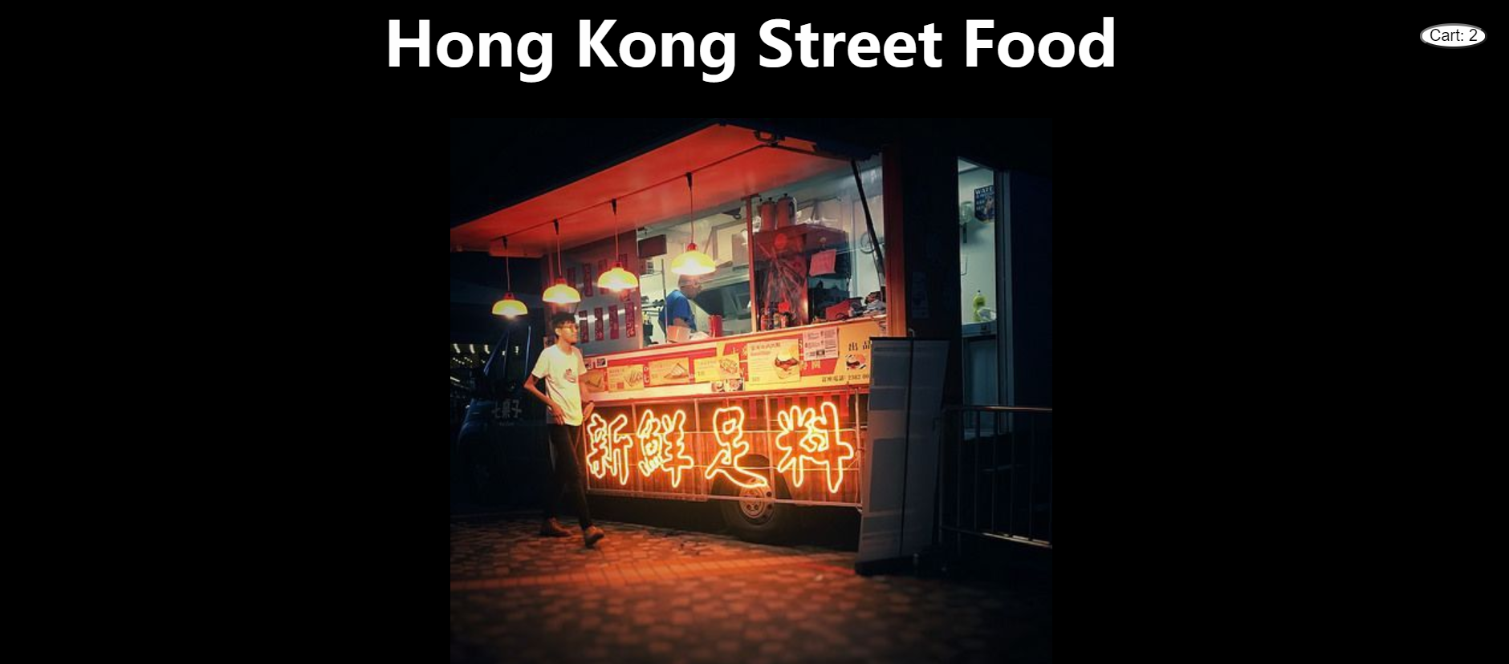
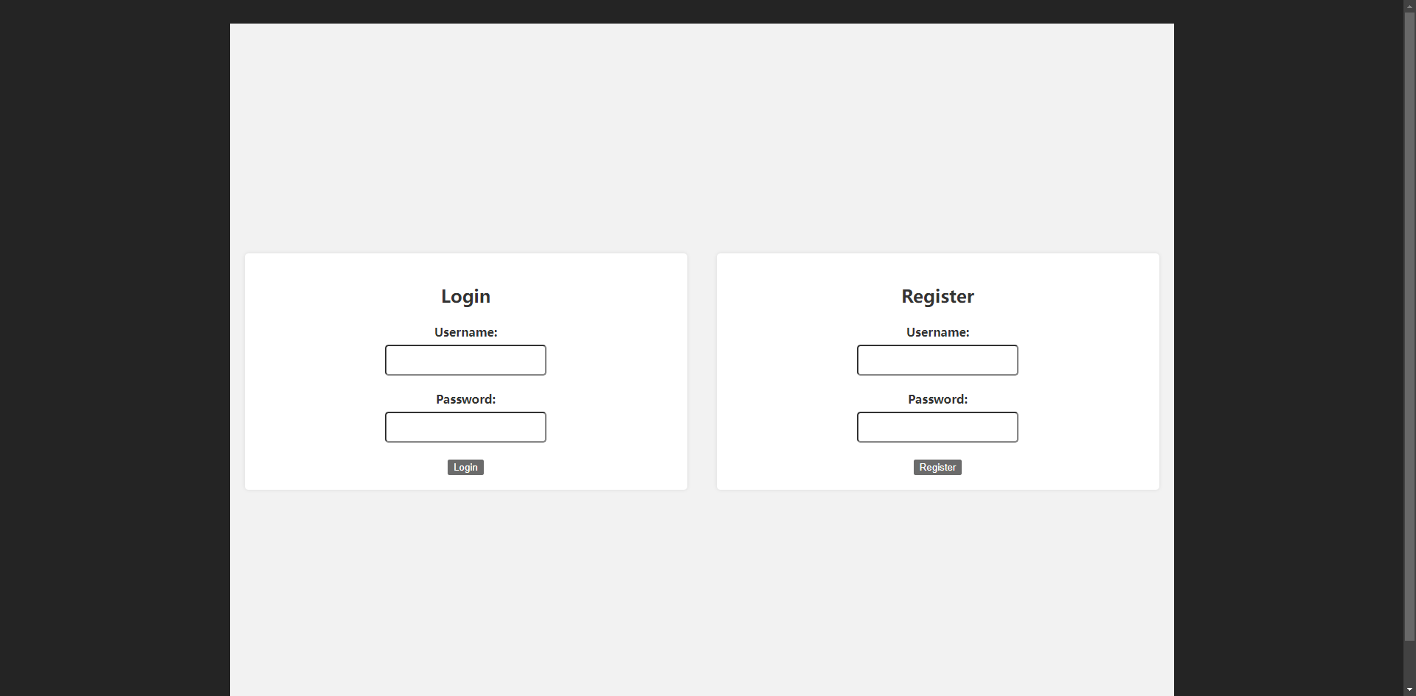
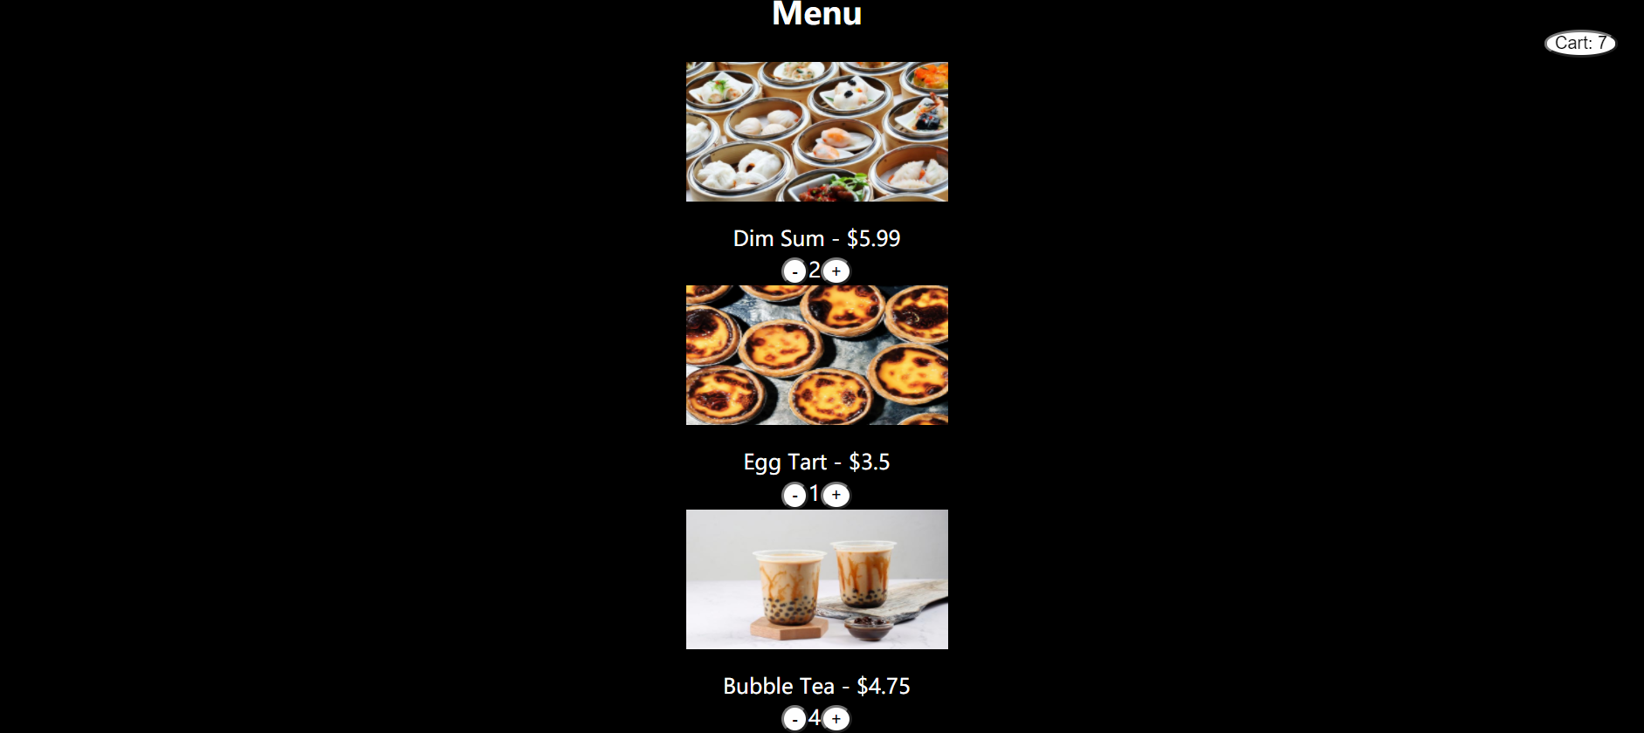
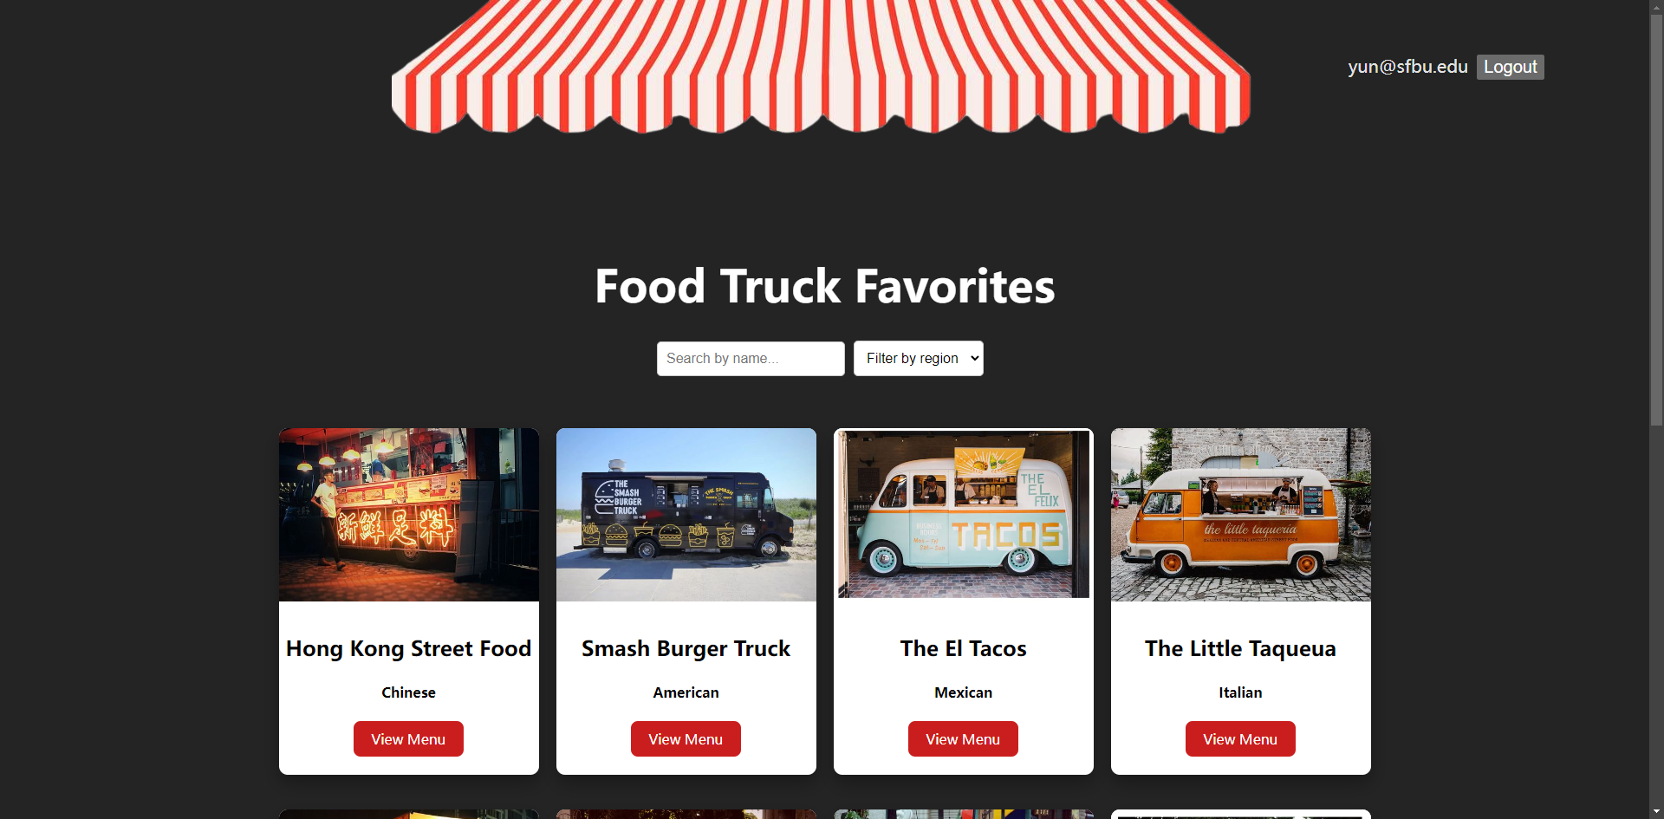
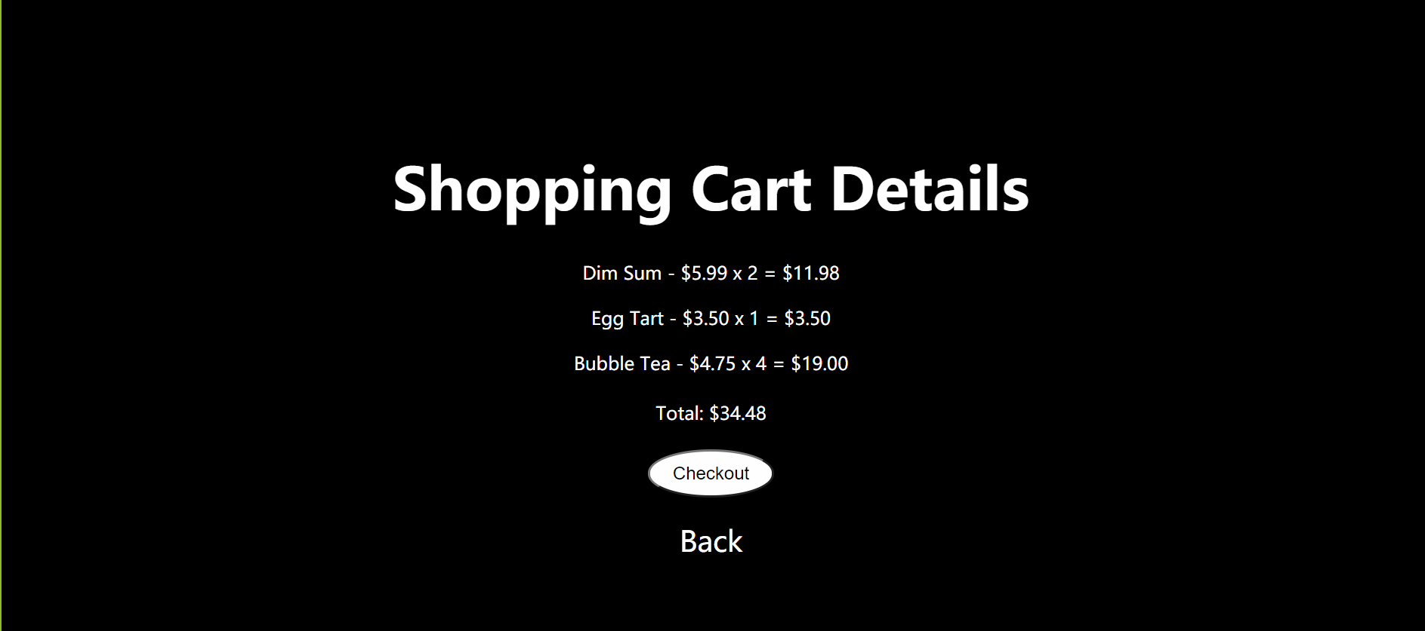
UI Design

Slide 4
Demo implementation

Slide 5
Thank you

